Slide 1


Noida Institute of Engineering and Technology, Greater Noida
Local search algorithms and optimistic problems
Unit: 02
Introduction to Search
B Tech 3rd Sem
Alka Singh
CSE (AIML)

Slide 2
Local Search and Optimization
Previous lecture : path to goal is solution to problem
- systematic exploration of search space
This lecture : a state is solution to problem
  - for some problem path is irrelevant
  - E.g , 8-queens
  Different algorithms can be used
    Depth First Branch and Bound
    Local search

Slide 3
Local Search and Optimization
Local search
  Keep track of single current state
  Move only to neighboring states
  Ignore path
  Advantages:
  Use very little memory
  Can often find reasonable solutions in large or infinite state space

Slide 4
Local Search and Optimization
“Pure Optimization” problems
  All states have an objective function
  Goal is to find state with max(or min) objective value
  Does not quite fit into path-cost/goal-state formulation
  Local search can do quite well on these problems

Slide 5
Hill Climbing Algorithm in AI
Hill climbing algorithm is a local search algorithm which continuously moves in the direction of increasing elevation/value to find the peak of the mountain or best solution to the problem.
It terminates when it reaches a peak value where no neighbor has a higher value.
Hill climbing algorithm is a technique which is used for optimizing the mathematical problems.

Slide 6
Continue…
Examples of Hill climbing algorithm is Traveling-salesman Problem in which we need to minimize the distance traveled by the salesman.
It is also called greedy local search as it only looks to its good immediate neighbor state and not beyond that.
A node of hill climbing algorithm has two components which are state and value.
Hill Climbing is mostly used when a good heuristic is available.
In this algorithm, we don't need to maintain and handle the search tree or graph as it only keeps a single current state.

Slide 7
Features of Hill Climbing
Following are some main features of Hill Climbing Algorithm:
Generate and Test variant: Hill Climbing is the variant of Generate and Test method. The Generate and Test method produce feedback which helps to decide which direction to move in the search space.
Greedy approach: Hill-climbing algorithm search moves in the direction which optimizes the cost.
No backtracking: It does not backtrack the search space, as it does not remember the previous states.

Slide 8
Simple Hill climbing
Simple hill climbing is the simplest way to implement a hill climbing algorithm.
It only evaluates the neighbor node state at a time and selects the first one which optimizes current cost and set it as a current state.
It only checks it's one successor state, and if it finds better than the current state, then move else be in the same state. This algorithm has the following features:
Less time consuming
Less optimal solution and the solution is not guaranteed

Slide 9
Algorithm of Hill Climbing
Step 1: Evaluate the initial state, if it is goal state then return success and Stop.
Step 2: Loop Until a solution is found or there is no new operator left to apply.
Step 3: Select and apply an operator to the current state.
Step 4: Check new state:
  If it is goal state, then return success and quit.

Slide 10
Continue…
  Else if it is better than the current state then assign new state as a current state.
  Else if not better than the current state, then return to step2.
Step 5: Exit.

Slide 11
State Space diagram for Hill Climbing
State space diagram is a graphical representation of the set of states our search algorithm can reach vs the value of our objective function(the function which we wish to maximize).
X-axis : denotes the state space ie states or configuration our algorithm may reach.
Y-axis : denotes the values of objective function corresponding to a particular state.
The best solution will be that state space where objective function has maximum value(global maximum).

Slide 12
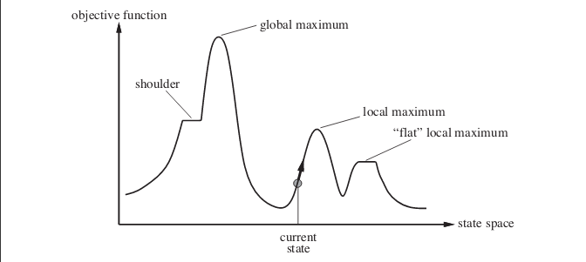
Different regions in the State Space Diagram

Slide 13
Different regions in the State Space Diagram
Local maximum: It is a state which is better than its neighboring state however there exists a state which is better than it(global maximum). This state is better because here the value of the objective function is higher than its neighbors.
Global maximum : It is the best possible state in the state space diagram. This because at this state, objective function has highest value.
Plateau/flat local maximum : It is a flat region of state space where neighboring states have the same value.

Slide 14
Different regions in the State Space Diagram
Ridge : It is region which is higher than its neighbours but itself has a slope. It is a special kind of local maximum.
Current state : The region of state space diagram where we are currently present during the search.
Shoulder : It is a plateau that has an uphill edge.

Slide 15
Problems in different regions in Hill climbing
Hill climbing cannot reach the optimal/best state(global maximum) if it enters any of the following regions :
Local maximum : At a local maximum all neighboring states have a values which is worse than the current state. Since hill-climbing uses a greedy approach, it will not move to the worse state and terminate itself. The process will end even though a better solution may exist.

Slide 16
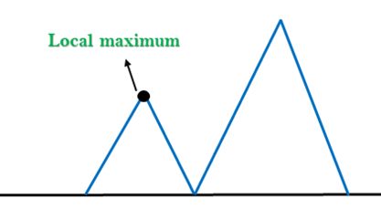
Problems in different regions in Hill climbing
Solution: Backtracking technique can be a solution of the local maximum in state space landscape. Create a list of the promising path so that the algorithm can backtrack the search space and explore other paths as well.

Slide 17
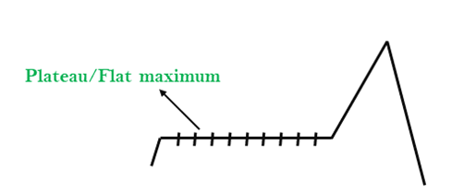
Problems in different regions in Hill climbing
Plateau : On plateau all neighbors have same value . Hence, it is not possible to select the best direction.

Slide 18
Problems in different regions in Hill climbing
Solution: The solution for the plateau is to take big steps or very little steps while searching, to solve the problem. Randomly select a state which is far away from the current state so it is possible that the algorithm could find non-plateau region.

Slide 19
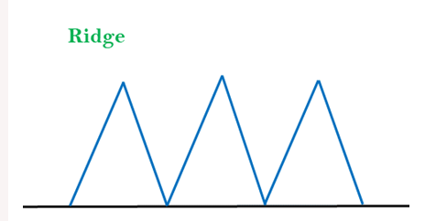
Problems in different regions in Hill climbing
Ridge : Any point on a ridge can look like peak because movement in all possible directions is downward. Hence the algorithm stops when it reaches this state.

Slide 20
Problems in different regions in Hill climbing
Solution: With the use of bidirectional search, or by moving in different directions, we can improve this problem.

Slide 21
Steepest-Ascent hill climbing:
The steepest-Ascent algorithm is a variation of simple hill climbing algorithm.
This algorithm examines all the neighboring nodes of the current state and selects one neighbor node which is closest to the goal state.
This algorithm consumes more time as it searches for multiple neighbors

Slide 22
Algorithm for Steepest-Ascent hill climbing:
Step 1 : Evaluate the initial state. If it is a goal state then stop and return success. Otherwise, make initial state as current state.
Step 2 : Repeat these steps until a solution is found or current state does not change
a) Select a state that has not been yet applied to the current state.
b) Initialize a new ‘best state’ equal to current state and apply it to produce a new state.

Slide 23
Algorithm for Steepest-Ascent hill climbing:
c) Perform these to evaluate new state
i. If the current state is a goal state, then stop and return success.
ii. If it is better then best state, then make it best state else continue loop with another new state.
d) Make best state as current state and go to Step 2
Step 3 : Exit

Slide 24
Stochastic hill climbing:
Stochastic hill climbing does not examine for all its neighbor before moving. Rather, this search algorithm selects one neighbor node at random and decides whether to choose it as a current state or examine another state.

Slide 25
Algorithm for Stochastic hill climbing:
Step 1: Evaluate the initial state. If it is a goal state then stop and return success. Otherwise, make initial state as current state.
Step 2: Repeat these steps until a solution is found or current state does not change.
Select a state that has not been yet applied to the current state.
Apply successor function to the current state and generate all the neighbor states.

Slide 26
Algorithm for Stochastic hill climbing:
Among the generated neighbor states which are better than current state choose a state randomly (or based on some probability function).
If the choosen state is goal state, then return success, else make it current state and repeat step 2.
Step 3: Exit.

Slide 27
MCQ
Q1. In many problems the path to goal is irrelevant, this class of problems can be solved using ______
a) Informed Search Techniques
b) Uninformed Search Techniques
c) Local Search Techniques
d) Informed & Uninformed Search Techniques

Slide 28
MCQ
Q2. Though local search algorithms are not systematic, key advantages would include __________
a) Less memory
b) More time
c) Finds a solution in large infinite space
d) Less memory & Finds a solution in large infinite space

Slide 29
MCQ
Q3. A complete, local search algorithm always finds goal if one exists, an optimal algorithm always finds a global minimum/maximum.
a) True
b) False

Slide 30
MCQ
Q 4. _______________ is an algorithm, a loop that continually moves in the direction of increasing value that is uphill.
a) Up-Hill Search
b) Hill-Climbing
c) Hill algorithm
d) Reverse-Down-Hill search

Slide 31
MCQ
Q 5. When will Hill-Climbing algorithm terminate?
a) Stopping criterion met
b) Global Min/Max is achieved
c) No neighbor has higher value
d) All of the mentioned

Slide 32
MCQ
Q6. What are the main cons of hill-climbing search?
a) Terminates at local optimum & Does not find optimum solution
b) Terminates at global optimum & Does not find optimum solution
c) Does not find optimum solution & Fail to find a solution
d) Fail to find a solution

Slide 33
MCQ
Q7. Hill climbing sometimes called ____________ because it grabs a good neighbor state without thinking ahead about where to go next.
a) Needy local search
b) Heuristic local search
c) Greedy local search
d) Optimal local search

Slide 34
MCQ
Q8. Hill-Climbing approach stuck for which of the following reasons?
a) Local maxima
b) Ridges
c) Plateau
d) All of the mentioned

Slide 35
Means-Ends Analysis
Means-Ends Analysis is problem-solving techniques used in Artificial intelligence.
It is a mixture of Backward and forward search technique.
The MEA technique was first introduced in 1961 by Allen Newell, and Herbert A. Simon in their problem-solving computer program, which was named as General Problem Solver (GPS).
The MEA analysis process centered on the evaluation of the difference between the current state and goal state.

Slide 36
How means-ends analysis Works:
Means end analysis uses the following processes to achieve its objectives:
First, the system evaluates the current state to establish whether there is a problem. If a problem is identified, then it means that an action should be taken to correct it.
The second step involves defining the target or desired goal that needs to be achieved.

Slide 37
How means-ends analysis Works:
3. The target goal is split into sub-goals, that are further split into other smaller goals.
4. This step involves establishing the actions or operations that will be carried out to achieve the end state.
5. In this step, all the sub-goals are linked with corresponding executable actions (operations).

Slide 38
How means-ends analysis Works:
6. After that is done, intermediate steps are undertaken to solve the problems in the current state. The chosen operators will be applied to reduce the differences between the current state and the end state.
7. This step involves tracking all the changes made to the actual state. Changes are made until the target state is achieved.

Slide 39
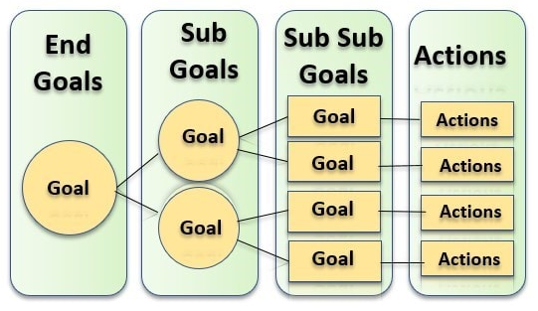
How means-ends analysis Works:
The following image shows how the target goal is divided into sub-goals, that are then linked with executable actions.

Slide 40
Algorithm for Means-Ends Analysis:
The following are the algorithmic steps for means end analysis:
Conduct a study to assess the status of the current state. This can be done at a macro or micro level.
Capture the problems in the current state and define the target state. This can also be done at a macro or micro level.

Slide 41
Algorithm for Means-Ends Analysis:
3. Make a comparison between the current state and the end state that you defined. If these states are the same, then perform no further action. This is an indication that the problem has been tackled. If the two states are not the same, then move to step 4.
4. Record the differences between the two states at the two aforementioned levels (macro and micro).

Slide 42
Algorithm for Means-Ends Analysis:
5. Transform these differences into adjustments to the current state.
6. Determine the right action for implementing the adjustments in step 5.
7. Execute the changes and compare the results with the target goal.

Slide 43
Algorithm for Means-Ends Analysis:
8. If there are still some differences between the current state and the target state, perform course correction until the end goal is achieved.

Slide 44
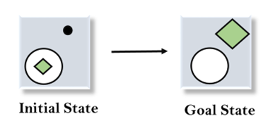
Example of Mean-Ends Analysis:
Let's take an example where we know the initial state and goal state as given below. In this problem, we need to get the goal state by finding differences between the initial state and goal state and applying operators.

Slide 45
Example of Mean-Ends Analysis:
Solution:
To solve the above problem, we will first find the differences between initial states and goal states, and for each difference, we will generate a new state and will apply the operators. The operators we have for this problem are:
Move
Delete
Expand

Slide 46
Example of Mean-Ends Analysis:
Evaluating the initial state: In the first step, we will evaluate the initial state and will compare the initial and Goal state to find the differences between both states.

Slide 47
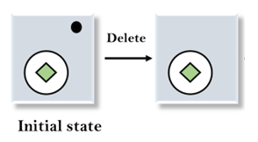
Example of Mean-Ends Analysis:
2. Applying Delete operator: As we can check the first difference is that in goal state there is no dot symbol which is present in the initial state, so, first we will apply the Delete operator to remove this dot.

Slide 48
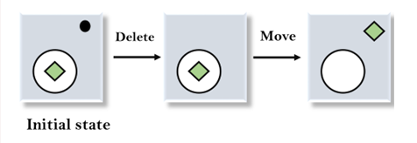
Example of Mean-Ends Analysis:
3. Applying Move Operator: After applying the Delete operator, the new state occurs which we will again compare with goal state. After comparing these states, there is another difference that is the square is outside the circle, so, we will apply the Move Operator.

Slide 49
Example of Mean-Ends Analysis:
4. Applying Expand Operator: Now a new state is generated in the third step, and we will compare this state with the goal state. After comparing the states there is still one difference which is the size of the square, so, we will apply Expand operator, and finally, it will generate the goal state.

Slide 50
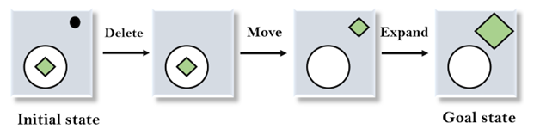
Example of Mean-Ends Analysis:

Slide 51
Applications of Means End Analysis
Organizational planning
Means end analysis is used in organizations to facilitate general management. It helps organizational managers to conduct planning to achieve the objectives of the organization. The management reaches the desired goal by dividing the main goals into sub-goals that are linked with actionable tasks.

Slide 52
Applications of Means End Analysis
Business transformation
This technique is used to implement transformation projects. If there are any desired changes in the current state of a business project, means end analysis is applied to establish the new processes to be implemented. The processes are split into sub-processes to enhance effective implementation.

Slide 53
Applications of Means End Analysis
Gap analysis
Gap analysis is the comparison between the current performance and the required performance. Means end analysis is applied in this field to compare the existing technology and the desired technology in organizations. Various operations are applied to fill the existing gap in technology.

Slide 54
References
American Association for Artificial Intelligence (AAAI), Welcome to AI Topics, 2003, http://www.aaai.org/AITopics/ -- a Web-based library.
George Luger, Artificial Intelligence: Structures and Strategies for Complex Problem Solving, Fourth Edition Addison-Wesley, 2002 -- a well-respected introduction to artificial intelligence, as witnessed by its being in its fourth edition.
Peter Norvig, AI on the Web, http://aima.cs.berkeley.edu/ai.html -- a list of over 800 links on various aspects of artificial intelligence.

Slide 55


